Slide 1
Analysis of scRNA-seq data using bioconductor
Theory + Practice

Slide 2
Basic analysis of scRNA data using Bioconductor
1. Clustering
2. Differential expression
Notes:
Papalexi E and Satija R. Single-cell RNA sequencing to explore immune cell heterogeneity, Nature Reviews Immunology 2018 (https://doi.org/10.1038/ nri.2017.76)

Slide 3
1. Clustering
One of the most promising applications of scRNA-seq is discover and annotating novel cell types. Computationally, this is a difficult problem because it is equivalent to unsupervised clustering. That is, we need to identify cell populations based on transcriptome similarity without any a priori knowledge. Moreover, in most cases, we do not even know a priori to determine how many clusters to divide into. This problem becomes even more challenging due to the high level of noise (technical and biological) and high-dimensions (i.e., genes).
When working with large datasets, it is often beneficial to apply some dimensionality reduction method. By mapping the data into a lower dimensional space, one is often able to significantly reduce the amount of noise. Another benefit is that it is often easier to visualize data in a two- or three-dimensional subspace.
Unsupervised clustering is useful in several applications and has been extensively studied in the field of machine learning. Some of the most popular methods include hierarchical clustering, k-mean clustering, and graph-based clustering.

Slide 4
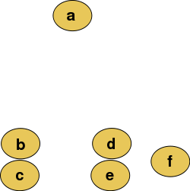
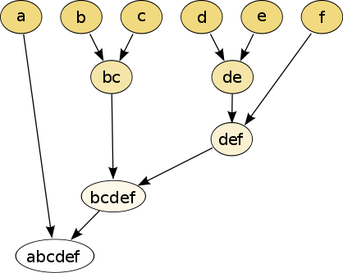
1.1 Hierarchical clustering
Hierarchical clustering is a method of grouping data points into clusters based on their similarity or dissimilarity. The algorithm starts by considering each data point as its own cluster and then merges the closest two clusters into a single cluster. This process is repeated until all data points belong to the same cluster.
There are two main types of hierarchical clustering: agglomerative and divisive. Agglomerative clustering starts with each data point as its own cluster and merges them into larger clusters. Divisive clustering starts with all data points in one cluster and recursively splits it into smaller clusters.
Distance measures, such as Euclidean distance or cosine similarity, are used to determine the distance between data points or clusters. Various linkage criteria can be employed to determine how clusters are merged or split, including single linkage, complete linkage, and average linkage.
The result of hierarchical clustering is a tree-like diagram called a dendrogram, which displays the relationships and hierarchical structure among different clusters. The height of the branches in the dendrogram represents the distance between different clusters, with lower branches indicating closer proximity. By examining the dendrogram, one can determine the optimal number of clusters based on the problem being studied. For example, a cut-off can be chosen at a certain height in the dendrogram to obtain the desired number of clusters.

Slide 5
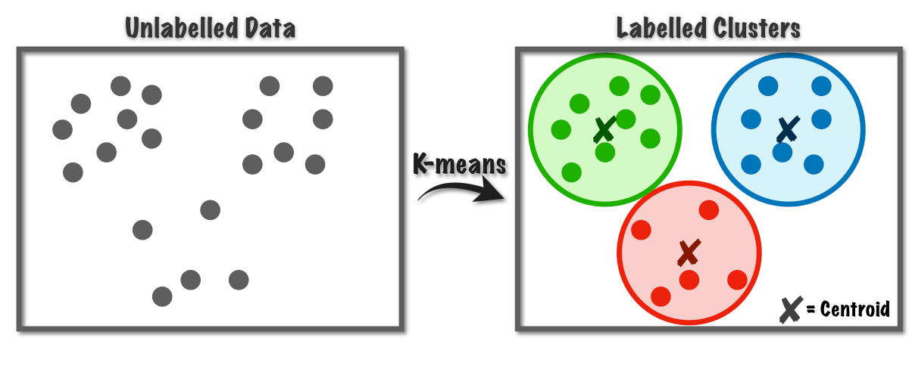
1.2 k-means clustering
K-means clustering is a method of grouping similar data points into clusters based on their similarity or dissimilarity.
The algorithm starts by randomly selecting k centroids, which represent the center points of each cluster. Then, based on a distance measure such as Euclidean distance, each data point is assigned to the nearest centroid. After the initial assignment, the algorithm calculates the average of all data points within each cluster and moves the centroid to this new position. Then, based on the updated centroid positions, each data point is reassigned to the nearest centroid. This process of updating centroids and reassigning data points is repeated until convergence, which occurs when the centroids no longer move or their movement falls below a specified threshold.
The result of K-means clustering is a set of k clusters, where each data point belongs to the cluster associated with its nearest centroid. The algorithm does not guarantee finding the global optimum, but it can converge to a local optimum that minimizes the within-cluster sum of squares (WSS).
An important consideration in K-means clustering is choosing the desired number of clusters, denoted as k. There are several methods to determine the optimal value of k, including the elbow method and the silhouette score method.

Slide 6
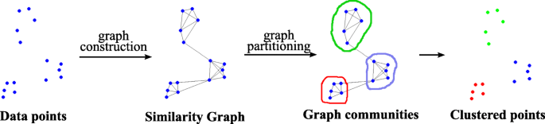
1.3 graph-based clustering algorithm
Graph-based clustering algorithms utilize a graph or network to represent the relationships between data points. Each data point is represented as a node in the graph, and the relationships between data points are represented by edges between the nodes. The algorithm then partitions the graph into groups of highly connected nodes while minimizing the connections between groups. This approach is based on the idea that data points that are highly connected to each other are likely to belong to the same cluster.
Let's say we have a set of data points representing customers in a shopping mall, and we want to classify them based on their shopping behaviors. We can represent the relationships between customers using a graph, where each customer is a node and edges represent the frequency of shopping together between two customers. Then, we can use graph-based clustering algorithms such as spectral clustering or hierarchical clustering using minimum spanning trees to partition the graph into groups of customers who tend to shop together. The algorithm will identify clusters of highly connected nodes, which correspond to groups of customers with similar shopping behaviors. For example, the algorithm might identify a group of customers who frequently buy clothing together and another group who frequently purchase electronics together. By using graph-based clustering algorithms, we can gain a better understanding of underlying patterns in the data and identify groups of customers with similar behaviors.
https://appliednetsci.springeropen.com/articles/10.1007/s41109-019-0248-7

Slide 7
Common clustering methods in scRNA
1）SINCERA
Based on hierarchical clustering
Data is converted to z-scores before clustering
Identify k by finding the first singleton clusters in the hierarchy
https://research.cchmc.org/pbge/sincera.html
2) SC3 pipeline (Consensus Clustering of Single-Cell RNA-Seq Data)
Based on PCA and spectral dimensionality reduction
Using k-means algorithm
Consistent clustering is also performed
3) tSNE + k-means method
Based on tSNE maps
Using k-means
4) Seurat method
Seurat provides an independent clustering algorithm based on a community detection method

Slide 8
2. Differential expression analysis
The most common analysis of RNA-seq is identifying differentially expressed genes (DEG).
Unlike the analysis of bulk RNA-seq, the differential expression analysis of scRNA-seq usually refers to the comparison between different cell populations. Once the different cell types are identified, we can obtain the DEGs between sub-populations (as implemented in SC3 with the Kruskal-Wallis test).
For bulk RNA-seq data, several methods have been developed, including the common DESeq2 and edgeR.
Some RNA-seq datasets with DEGs validated by RT-qPCR can be used to evaluate the performance of different algorithms.
https://genomebiology.biomedcentral.com/articles/10.1186/gb-2013-14-9-r95

Slide 9
2.1 Basis of differential expression analysis
Unlike bulk RNA-seq, in single-cell experiments, we typically have a large number of samples (i.e., cells) to compare within each group. Therefore, we can use the overall distribution of expression values within each group to determine differences between groups, rather than comparing only the estimated mean expression levels as in standard bulk RNA-seq. There are two main approaches to comparing distributions.
First, we can use existing statistical models/distributions to fit the same type of model to the expression values of each group and then test for differences in the model parameters or test if allowing a specific parameter to vary by group improves the model fit. For example, we can use edgeR to test if allowing different batch-specific average expression levels significantly improves the fit of the negative binomial model to the data.
Second, we can use non-parametric tests, which do not assume that expression values follow any specific distribution, such as the Kolmogorov-Smirnov test (KS-test). Non-parametric tests typically convert the observed expression values into ranks and test whether the rank distribution of one group is significantly different from the rank distribution of another group. However, some non-parametric methods may fail when there are a large number of tied values, such as dropout (zero) events in single-cell RNA-seq expression data.
Note that if the assumptions of parametric tests hold, they generally have more power than non-parametric tests.

Slide 10
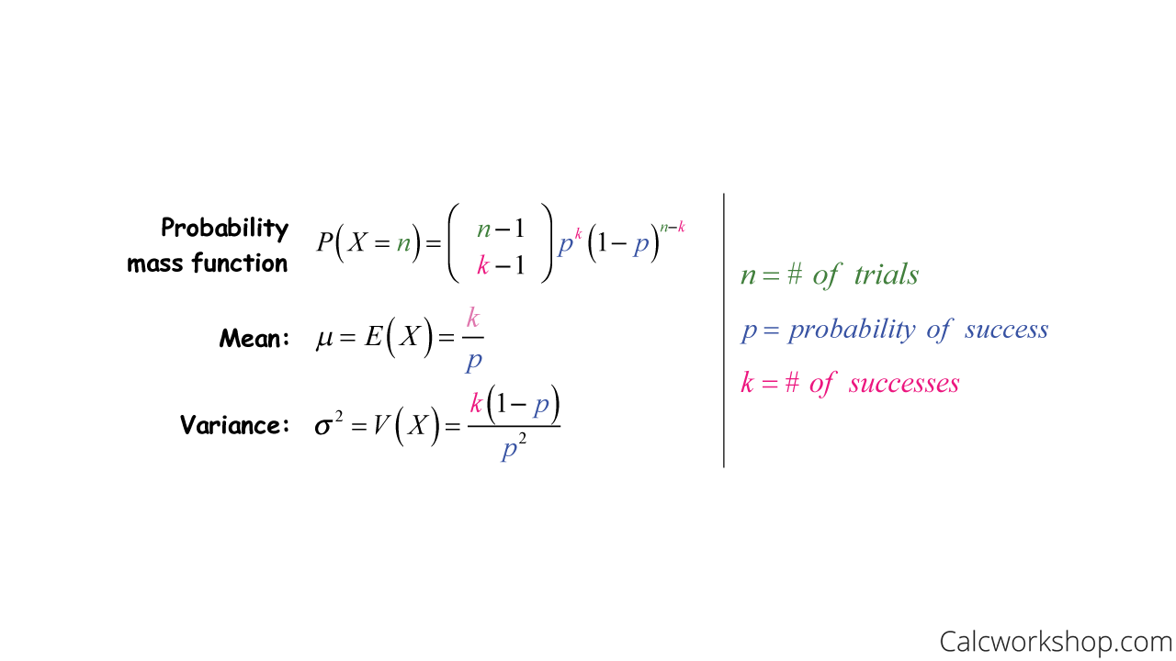
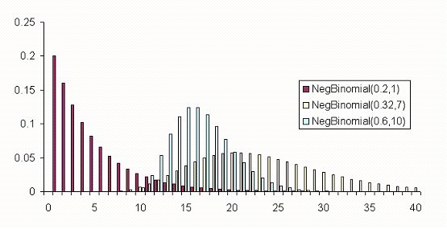
2.2 Modeling of scRNA-seq data
1) negative binomial model (negative binomial model)
The most common model for scRNA-seq data (edgeR)
Two parameters: the mean expression (mu) and the dispersion (size), which is inversely proportional to the variance.
The negative binomial model fits large amounts of RNA-seq data well, and it is used in most statistical methods designed for such data. In addition, it has been shown to work well for the distribution of molecule numbers obtained from UMI-labeled data.
However, the original negative binomial model does not fit well with full-length transcript data due to the high dropout rate relative to non-zero reads.
Frequency
Read count

Slide 11
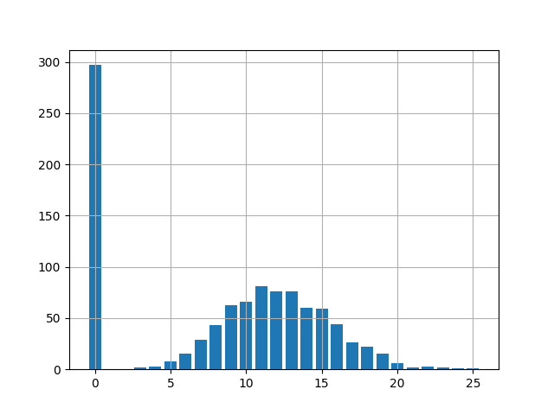

2) Zero-inflate negative binomial model (zero-inflate NB)
A new parameter d , the drop-out rate, is introduced in the negative binomial model. in the previous practice we can see that the drop-out rate of a gene is closely related to the average expression of that gene.
Different zero-inflated negative binomial models use different relationships between mu and d, and some models may fit mu and d to the expression of each gene independently.
MAST tool: https://bioconductor.org/packages/release/bioc/vignettes/MAST/inst/doc/MAST-Intro.html
SCDE tool: http://hms-dbmi.github.io/scde/

Slide 12
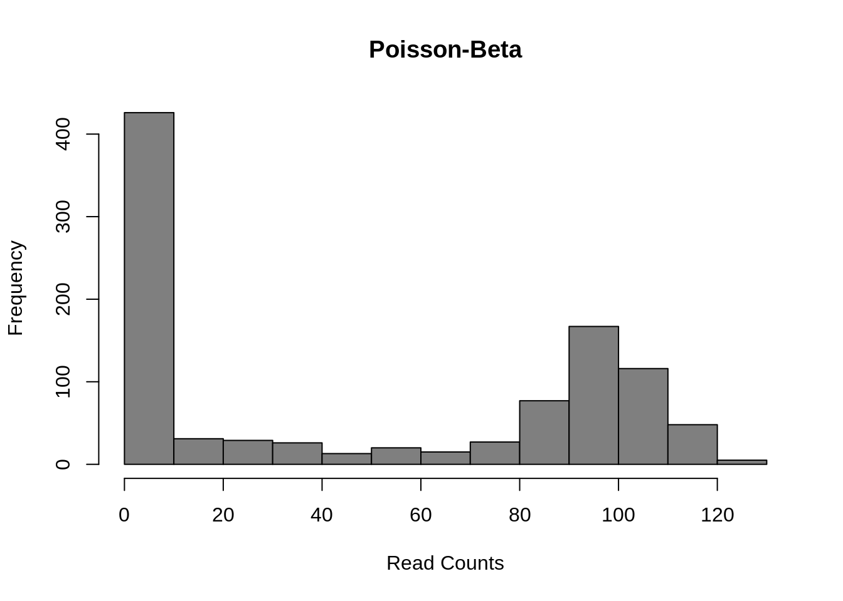

(3) Poisson-Beta distribution model (Poisson-Beta distribution)
Some methods use the Poisson-Beta distribution, which is based on a mechanistic model of transcriptional bursts.
It can be fitted well to scRNA-seq data, but it is not as easy to use as the negative binomial model, and there are far fewer methods available than the negative binomial model.
This model uses three parameters: a is the rate of activation of transcription; b is the rate of repression of transcription; and g is the rate of transcripts produced when transcription is active at the locus. Differential expression analysis can be done to test for differences between groups for each parameter, or only one of the parameters (usually g) can be tested.
BPSC tool: https://github.com/nghiavtr/BPSC

Slide 13
4) Non-parametric significance test method
The type of test that is easy to handle is a non-parametric test. The most commonly used nonparametric test is the Kolmogorov-Smirnov (KS) test, which we can use to compare the distribution of each gene in two individuals.The KS test quantifies the distance between the empirical cumulative distribution of expression of each gene in two populations. It is sensitive to changes in mean expression and variability. However, it assumes continuous data and may perform poorly when the data contain a large number of identical values (e.g., zero). Another problem with the KS test is that it may be very sensitive at larger sample sizes and thus may end up significantly even when differences are small.
The Wilcox rank sum test is another nonparametric test, but it specifically tests whether values in one group are greater/less than values in the other group. Therefore, it is often considered a test for comparing differences in median expressions between two groups; whereas the KS test is sensitive to any changes in the distribution of expression values.
Note: Many statistical tests and procedures are based on specific distributional assumptions. Normality assumptions are particularly common in classical statistical tests. Many reliability models are based on the assumption that the data follow a Weibull distribution. There are many nonparametric and robust techniques that are not based on strong distributional assumptions. By nonparametric, we mean a technique, such as the sign test, that is not based on specific distributional assumptions. By robust, we mean a statistical technique that performs well under a wide range of distributional assumptions. However, techniques based on specific distributional assumptions are usually more powerful than these nonparametric and robust techniques. By power, we mean the ability to detect differences when they are actually present. Therefore, if distributional assumptions can be confirmed, parametric techniques are generally preferred. If you are using a technique that has a normality (or other type of distribution) assumption, it is important to confirm that this assumption is in fact reasonable. If this is the case, more powerful parametric techniques can be used. If the distributional assumptions do not hold, it may be necessary to use non-parametric or robust techniques.
Notes:
https://www.itl.nist.gov/div898/handbook/eda/section3/eda35g.htm

